Slide 1
Design, strategi, management
Stefan Holmlid

Slide 2
Praktikperspektivet (Lave & Wenger, Schön)
En organisation består av samverkande praktiker
Samverkan möjliggörs/hindras av formell organisation
Samverkan drivs av styrning och ledning

Slide 3
Dynamic capability
Potential
knowledge acquisition which “refers to a firm’s capability to identify and acquire externally generated knowledge that is critical to its operations.”
assimilation capability which “refers to the firm’s routines and processes that allow it to analyze, process, interpret and understand the information obtained from external sources.”
Potential absorptive capacity makes the firm receptive to acquiring and assimilating external knowledge.

Slide 4
Dynamic capability
Realized
transformation capability which refers to “a firm’s capability to develop and refine the routines that facilitate combining existing knowledge and the newly acquired and assimilated knowledge.”
exploitation capability of a firm which which refers to the capacity of a firm to apply newly acquired knowledge in product or services that it can get benefit from.
Realized absorptive capacity is a function of the transformation and exploitation capabilities.

Slide 5
Kapacitet vs Förmåga
Capability (förmåga)
Vad man förmår göra, vad man åstadkommer, vad man klarar av
Capacity (kapacitet)
Vilka resurser man har för att fylla förmågan

Slide 6
 | Operativ | Taktisk | Strategisk

Slide 7
 | Operativ | Taktisk | Strategisk
Metoder
Verktyg
Relationer
Arbetsfördelning
Kompetenser
Kompetens-utveckling
Ledarskap
Motivation
Attityder

Slide 8
Designattityd, exempel Michlewski, http://designattitude.org/

Slide 9
Designattityd, exempel Michlewski, http://designattitude.org/

Slide 10
Designattityd, exempel Michlewski, http://designattitude.org/
Notes:
Exempel, agila metoder vs stagegate

Slide 11
Designtrappan Danish Design Center, SVID

Slide 12
Designtrappan, Danish Design Center, SVID
Steg 1 - Omedveten design
Design kan förekomma i företaget, men är inte något som ni arbetar med aktivt. Ni talar egentligen aldrig om design på företaget.
Steg 2 - Design som formgivning
Ni ser design som något som läggs till på slutet i ett utvecklingsarbete. Design är en fråga om form och utseende.
Steg 3 – Design som process
Ni ser design som en viktig del, men inte som styrande. Ni väljer design som arbetsform när något nytt ska utvecklas i er verksamhet.
Steg 4 – Design som strategi
Ni ser designmetodik som en central och styrande faktor i er verksamhetside. Design är en självklar ledningsfråga med ett eget strategiskt värde.
Notes:
Platta ut!!!

Slide 13
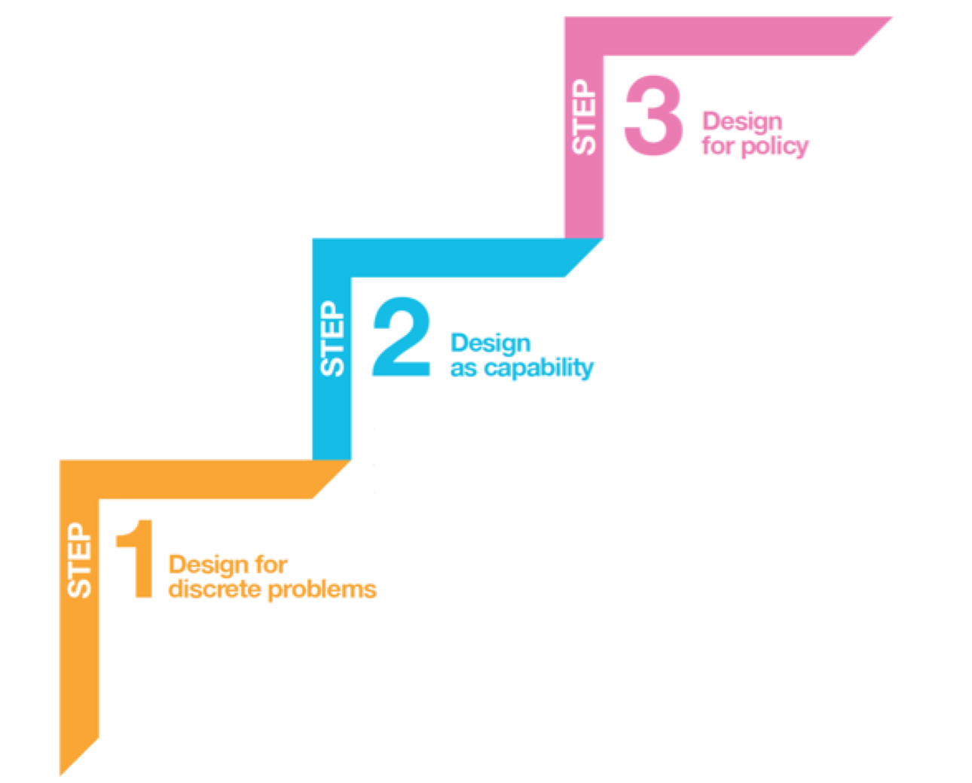
Designstegar Design for public good

Slide 14
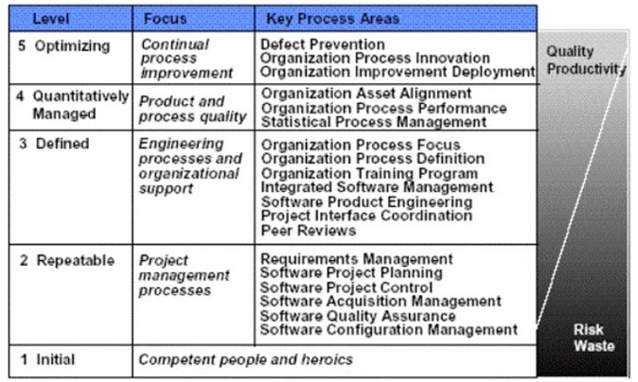
Processmognad

Slide 15
Strategi, taktik, operativt
Strategic planning is an organization’s process of defining its strategy, or direction, and making decisions on allocating its resources to pursue this strategy. Generally, strategic planning deals, on the whole business, rather than just an isolated unit
Tactical planning is short range planning emphasizing the current operations of various parts of the organization. anagers use tactical planning to outline what the various parts of the organization must do for the organization to be successful at some point one year or less into the future.
Operational planning is the process of linking strategic goals and objectives to tactical goals and objectives. It describes milestones, conditions for success and explains how, or what portion of, a strategic plan will be put into operation during a given operational period.
Notes:
Platta ut!!!

Slide 16
 | Operativ | Taktisk | Strategisk

Slide 17
 | Operativ | Taktisk | Strategisk
Metoder
Verktyg
Relationer
Arbetsfördelning
Kompetenser
Kompetens-utveckling
Ledarskap
Motivation
Attityder

Slide 18
Benefit levels
From Strassman, P. The business value of computers
Direct, indirect, inferred

Slide 19
Benefit levels, applied
Increased sales?

Slide 20
Benefit levels, applied
Increased sales!

Slide 21
Benefit levels, applied
Increased sales!
From competetive gain:
Increasing the customer base
Shifting customers from competitors (in same channel)
Changing behaviour of customers (not currently in the channel)
From performance improvement:
Better conversion rates
Better targeting of sale calls in relationship to actual & perceived offer

Slide 22
Design perspectives, and levels of benefits
Strategic
Aesthetics understood as e.g. brand
Functionality understood as e.g. the offering
Tactic
Aesthetics understood as e.g. producability
Functionality understood as e.g. division of labour
Operational
Aesthetics understood as e.g. the actual form
Functionality understood ase.g. the tasks that are supported

Slide 23
Exjobb?
Integrera designdriven innovation hos inkubatorer, science parks etc, för att stödja företag att introducera design
Göra designanalyser av företag
Utveckla arbetssätt för inkubatorer mfl
Hur funkar det med alla uppköp av designföretagen? Veryday blev McKinsey nyss, t.ex.

Slide 24
Stefan Holmlid
@shlmld

Slide 25
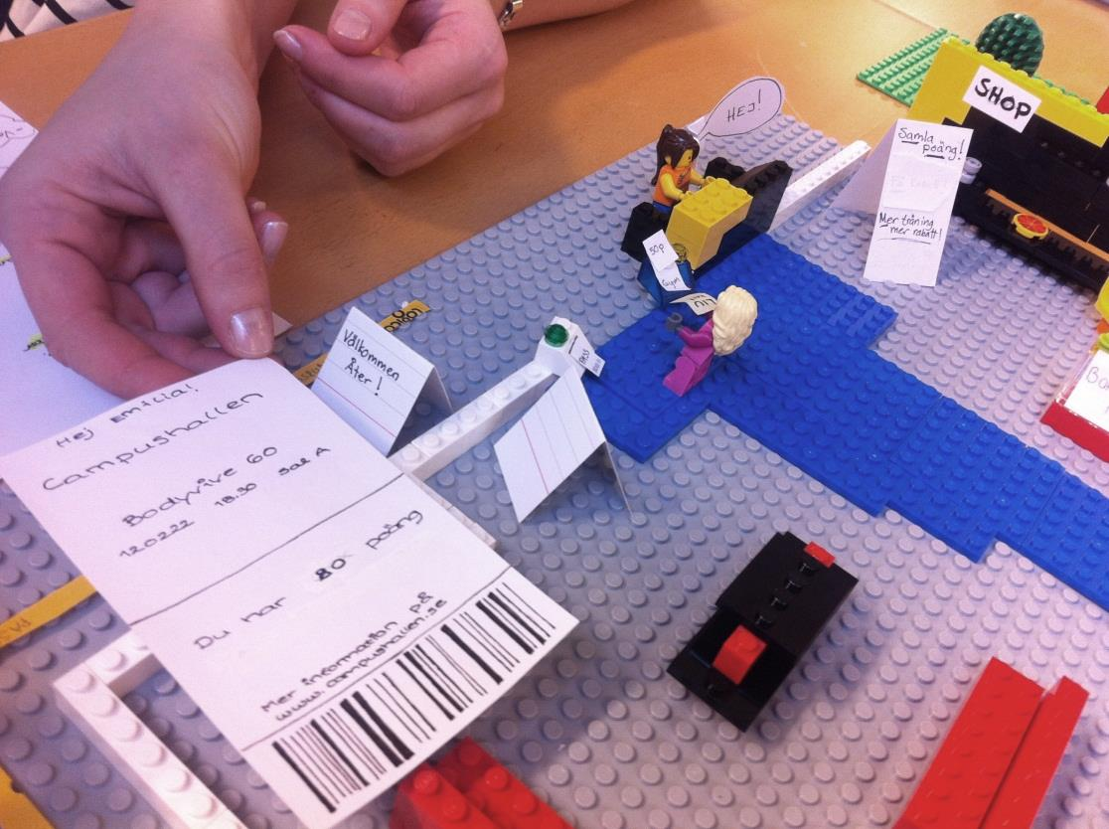
www.liu.se
Notes:
Spatial layout
The logic of the service
Social relations/interaction
Mixed materials – actual size of the _immersive_
(Explain what the service is.) there are many techniques

